Slide 2
Computational approaches for the therapeutic target discovery to ame-liorate muscle wasting during aging and disease
Msc Karen Guerrero Vazquez
Dr. Katarzyna Whysall
Dr. Pilib O Broin

Slide 3
Table of contents
Introduction to the problem
Objective of the project
Differential expression analysis
New database to easer access to microRNA information
Network analysis
Work in progress
Future work

Slide 4
The problem…

Slide 5

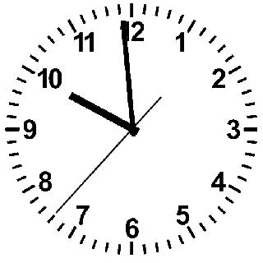

Slide 6
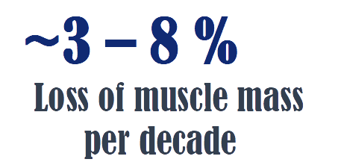

Slide 7
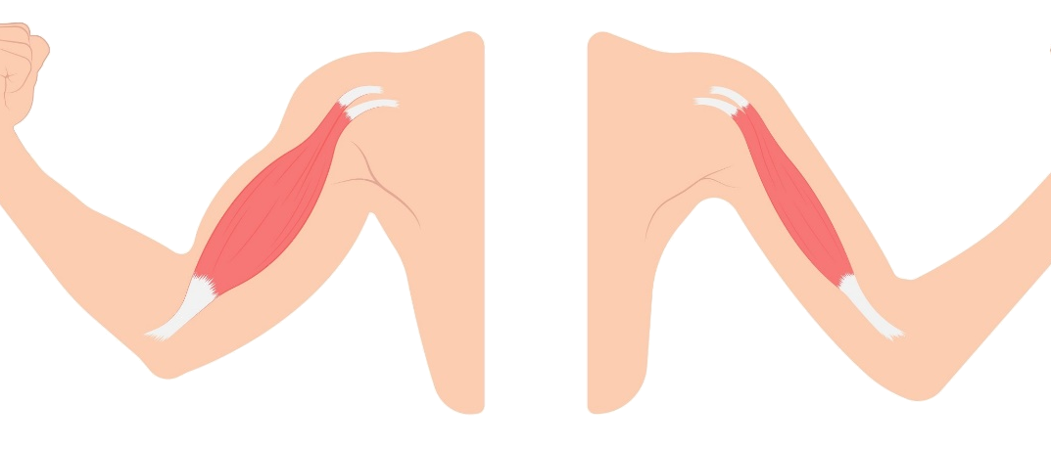

Slide 8
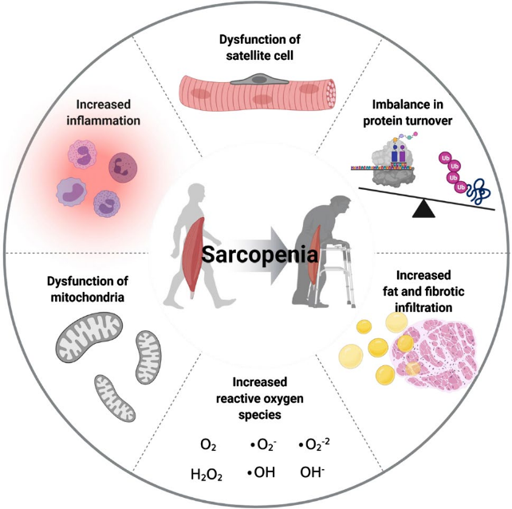

Slide 9
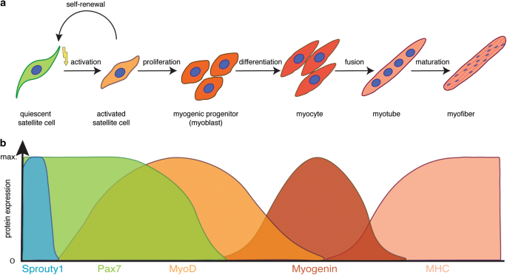

Slide 10
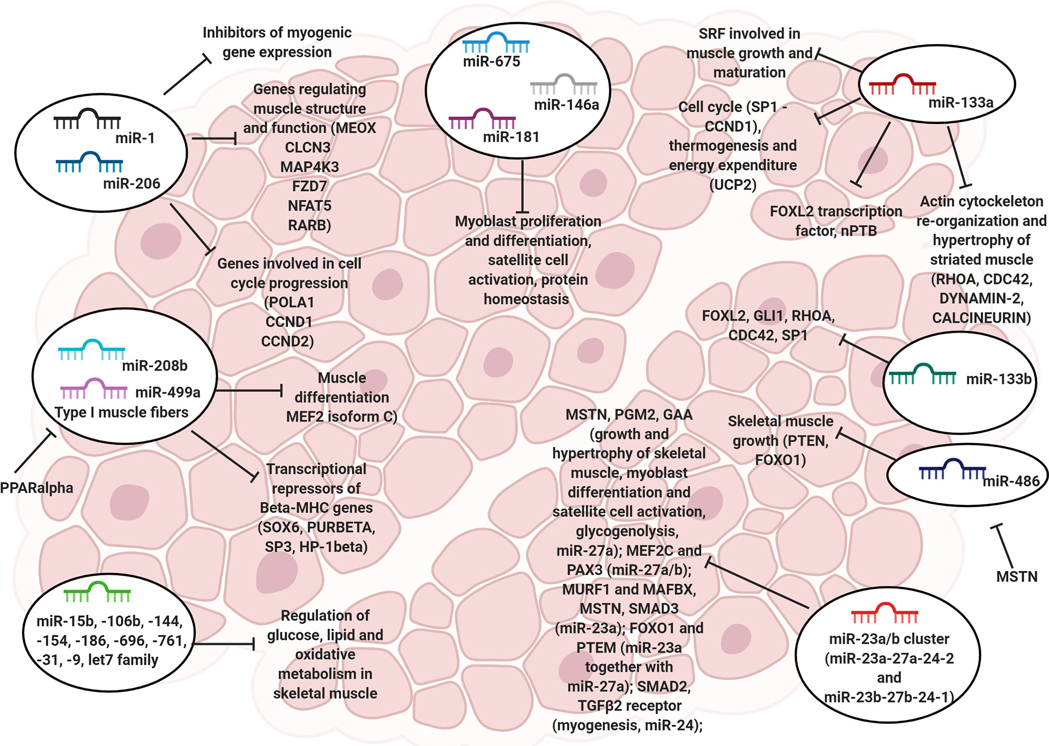

MicroRNA (miRNAs)

Slide 11
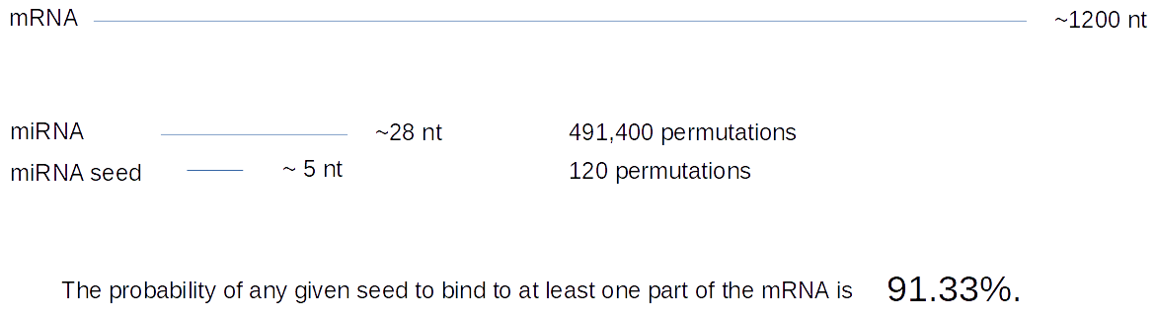
MicroRNA (miRNAs)

Slide 12
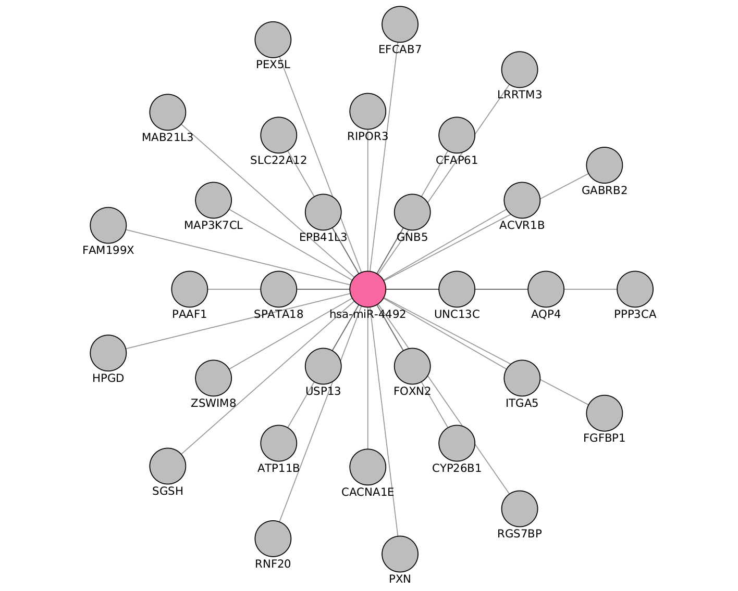
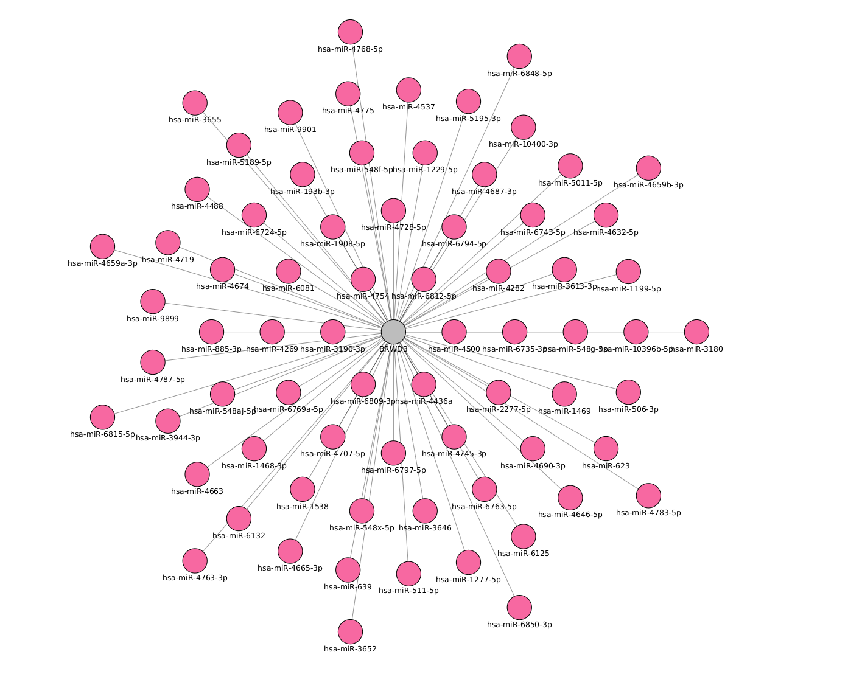

Slide 13
Objective

Slide 14
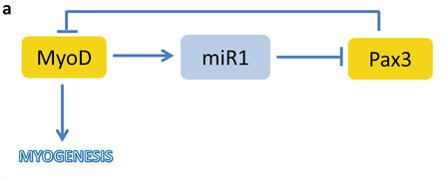
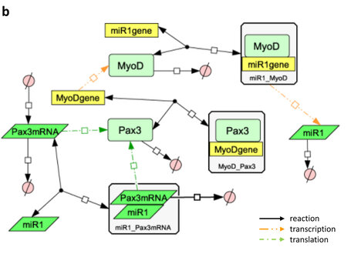
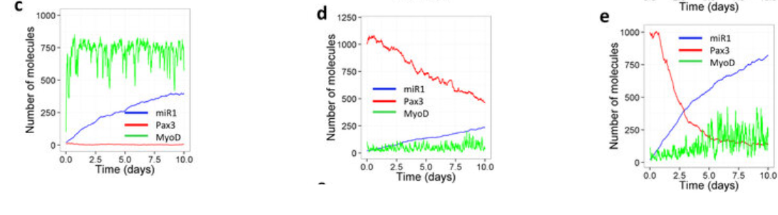

Slide 15
What are we going to do to archive this goal?
Creation a seed or genes
Recompile the microRNA metadata on a practical accessible way
Integrate the microRNA data with the genes
Select the gene and microRNA players
Generate the model with selected genes and microRNA
Validation

Slide 16
Differential expression analysis

Slide 17
Target | Type | N.Experiments | Healty | non-healty
mRNA | RNASeq | 3 | 3 | 0
 | MicroArray | 4 | 2 | 2
miRNA | MicroArray | 2 | 2 | 0
 | miRSeq | 1 | 0 | 1

Slide 18
Experiments
GEO number | Samples | Min Age | Max Age | Reference
GSE152558 | 5 | 41 | 85 | Tharakan, R., Ubaida-Mohien, C., Piao, Y., Gorospe, M., & Ferrucci, L. (2021).
GSE164471 | 53 | 34 | 80 | Tumasian III, R. A., Harish, A., Kundu, G., Yang, J. H., Ubaida-Mohien, C., Gonzalez-Freire, M., ... & Ferrucci, L. (2021).
GSE157585 | 136 | 19 | >65 | Kulkarni, A. S., Peck, B. D., Walton, R. G., Kern, P. A., Mar, J. C., Windham, S. T., ... & Peterson, C. A. (2020).
GSE87105 | 16 | 30 | 78 | Mercken, E. M., Capri, M., Carboneau, B. A., Conte, M., Heidler, J., Santoro, A., ... & de Cabo, R. (2017)..

Slide 19
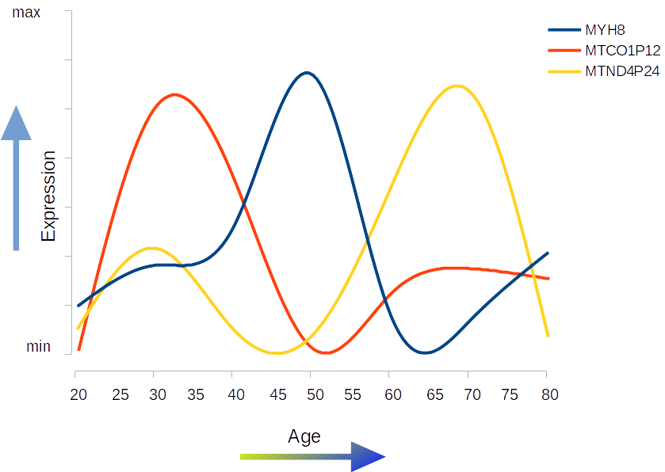




Slide 20
Differential expression
Quality evaluation: FastQC
Trimming adapters: cutadapt
Pseudo alignment: Kallisto
Mappint to Ensemble: tximport
Analysisi: DESeq2
Adjusted P-value: 0.1
LogFold Change: 1.0

Slide 21
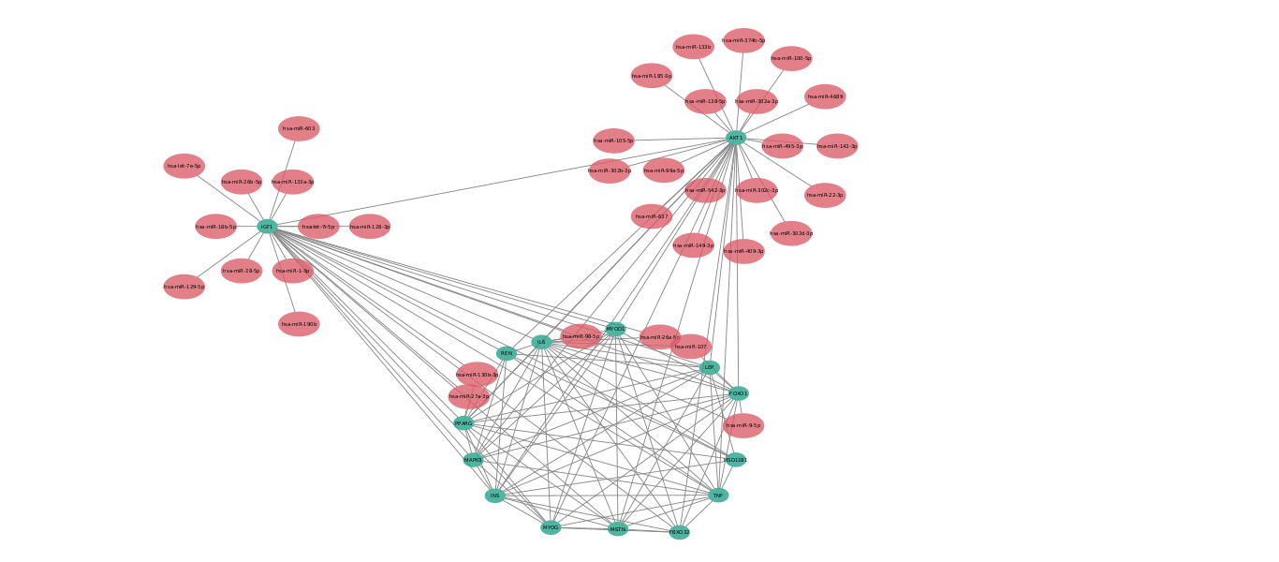

Slide 22
Thank You

Slide 23
Acknowledgements
This presentation has emanated from research conducted with the financial support of Science Foundation Ireland under Grant number [18/CRT/6214 ]

Slide 24
Chapters
Differential analysis: muscle during time
MiRKat DB; An integrated database for microRNAs
miRKat; Algorithms for the selection of microRNA targets
Bonus:
Execution of selected microRNAs in vitro (?)

